Slide 1

Unit 3 – Others Relational Influences, Weeks 6-8
LEARNING OBJECTIVES:
3.18 Distinguish types of solutions to conflict
3.19 Identify and explain techniques (mediation, negotiation, counselling) for resolving conflict
3.20 Explain the contributions of Harlow, Bowlby and Ainsworth to attachment theory
Assessments:
Task 7: Response – Topic Test 3 (Relational Influences; Communication) (5%) – Week 8, Friday 21 June, Period 5

Slide 2
Learning objective 3.18: Distinguish solutions to conflict

Slide 3
PAIR-SHARE
Activate Prior Knowledge
Define ‘effective communication’.
Identify factors that influence ‘effective communication’
Identify some of the consequences that may arise if communication is not effective

Slide 4
Conflict
Vocabulary
incompatible: not consistent or incapable of coexisting
Conflict occurs when there is a perception that two parties (individuals or groups) have incompatible goals, ideas or behaviours.
Concept Development
Possible causes?
Poor communication or miscommunication
Finances
Roles and responsibilities
Inequality
Misunderstandings
Time spent apart
Jealousy
Incompatible goals or beliefs
Checking for Understanding
Define conflict. Does conflict between two or more parties mean there is a real incompatibility between their situations? Explain two causes of conflict.

Slide 5
Conflict
Vocabulary
incompatible: not consistent or incapable of coexisting
Conflict occurs when there is a perception that two parties (individuals or groups) have incompatible goals, ideas or behaviours.
Concept Development
Benefits of conflict
Small amounts of conflict can be beneficial in a relationship
Changes can be made
Greater loyalty
Greater depth of understanding
Checking for Understanding
How can conflict be beneficial?

Slide 6
Conflict
Vocabulary
incompatible: not consistent or incapable of coexisting
Conflict occurs when there is a perception that two parties (individuals or groups) have incompatible goals, ideas or behaviours.
Concept Development
Dangers of conflict
With individuals, ongoing conflicts can lead to relationship breakdown
Within society, ongoing conflicts can lead to violence
On an international scale, conflict can lead to war
Checking for Understanding
How can conflict be dangerous?

Slide 7
Conflict
Vocabulary
incompatible: not consistent or incapable of coexisting
Conflict occurs when there is a perception that two parties (individuals or groups) have incompatible goals, ideas or behaviours.
Concept Development
Mirror-image perceptions
Both parties can form distorted perceptions of the other that are remarkably alike
Biased attributions are made
Each side thinks: we are great, you are awful!
Checking for Understanding
Explain the phenomena of mirror-image perceptions.

Slide 8
Conflict
Vocabulary
incompatible: not consistent or incapable of coexisting
Conflict resolution is a way for two or more parties to find a peaceful solution to a disagreement among them
Concept Development
Types of solution to resolve conflict
Imposed solutions
Distributive solutions
Integrative solutions
Checking for Understanding
Explain the phenomena of mirror-image perceptions.

Slide 9
Conflict
Vocabulary
incompatible: not consistent or incapable of coexisting
Conflict resolution is a way for two or more parties to find a peaceful solution to a disagreement among them
Concept Development
Imposed solutions
One party is stronger and imposes a solution
Or a third party intervenes and imposes a solution.
Example: a judge decides on custody or divorce proceedings
Checking for Understanding
Explain what imposed solutions are and provide an example.

Slide 10
Conflict
Vocabulary
incompatible: not consistent or incapable of coexisting
Conflict resolution is a way for two or more parties to find a peaceful solution to a disagreement among them
Concept Development
Distributive solutions
Involve compromise from both parties
Example: joint custody agreements following divorce
Checking for Understanding
Explain the difference between imposed solutions and distributive solutions.

Slide 11
Conflict
Vocabulary
incompatible: not consistent or incapable of coexisting
Conflict resolution is a way for two or more parties to find a peaceful solution to a disagreement among them
Concept Development
Integrative solutions
Win-win solution (Both sides benefit from the decision)
Ensure that the motives of each party are addressed rather than focusing on explicit demands
Checking for Understanding
Explain the difference between distributive and integrative solutions.

Slide 12


Learning objective 3.19: Identify and explain techniques (mediation, negotiation, and counselling) for resolving conflicts

Slide 13
PAIR-SHARE
Distinguish the following types of conflict resolution (identify similarities and differences between them):
Imposed solutions
Distributive solutions
Integrative solutions
Activate Prior Knowledge

Slide 14

Mediation
Vocabulary
conflict occurs when there is a perception that two parties (individuals or groups) have incompatible goals, ideas or behaviours. Integrative solutions: Win-win solutions where both parties are satisfied with the solution Distributive solutions: involves compromise from each party Imposed solutions: the stronger party or the
Mediation: A third party is brought in to help resolve the conflict. The mediator helps the parties to the dispute focus on the issues and reach a voluntary solution (either integrative or distributive).
Concept Development
Arbitration: A form of mediation in which the third party has the right to hand down a decision after listening to both sides present their arguments (leading to an imposed solution).
Checking for Understanding
What types of solutions to conflict result from the process of mediation?

Slide 15
Mediation
Vocabulary
conflict occurs when there is a perception that two parties (individuals or groups) have incompatible goals, ideas or behaviours. Integrative solutions: Win-win solutions where both parties are satisfied with the solution Distributive solutions: involves compromise from each party Imposed solutions: the stronger party or the
The Australian National Mediator Approval Standards defines mediation as:
A process in which the participants, with the support of a mediator, identify issues, develop options, consider alternatives and makes decisions about future actions and outcomes. The mediator acts as a third party to support participants to reach their own decisions.
Concept Development
Checking for Understanding
What are the steps in mediation you can identify in this definition? How does the ANMAS describe the role of the mediator?

Slide 16

The role of the mediator
Vocabulary
conflict occurs when there is a perception that two parties (individuals or groups) have incompatible goals, ideas or behaviours. Integrative solutions: Win-win solutions where both parties are satisfied with the solution Distributive solutions: involves compromise from each party Imposed solutions: the stronger party or the
Mediators:
Are impartial
Manage the process
Facilitate communication
Help the parties to hear and understand each other
Assist parties to evaluate alternatives and options
Mediators do not:
Give advice
Determine the solution
Concept Development
Checking for Understanding
Describe the role of the mediator in the mediation process.

Slide 17
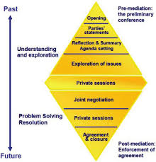

The mediation process
Vocabulary
conflict occurs when there is a perception that two parties (individuals or groups) have incompatible goals, ideas or behaviours. Integrative solutions: Win-win solutions where both parties are satisfied with the solution Distributive solutions: involves compromise from each party Imposed solutions: the stronger party or the
Concept Development
Checking for Understanding
Describe the mediation process.

Slide 18
The mediation process
Vocabulary
conflict occurs when there is a perception that two parties (individuals or groups) have incompatible goals, ideas or behaviours. Integrative solutions: Win-win solutions where both parties are satisfied with the solution Distributive solutions: involves compromise from each party Imposed solutions: the stronger party or the
Steps to conducting a mediation session:
Mediator opens (introduces sessions, establishes rapport; sets guidelines/rules; discusses confidentiality and role of the mediator)
Parties’ opening statements (Explain what has brought them here today; Mediator listens does not interrupt)
Mediator reflection and summary (make sure parties have heard each other)
Agenda setting (mediator identifies issues to discuss)
Issue exploration
Private sessions (discuss options and alternatives)
Negotiation
Agreement and closure
Concept Development
Checking for Understanding
Describe the mediation process.

Slide 19

The mediation process
Concept Development

Slide 20

Effectiveness of mediation
Vocabulary
conflict occurs when there is a perception that two parties (individuals or groups) have incompatible goals, ideas or behaviours. longitudinal research: an observational research method in which data is gathered for the same subjects repeatedly over a period of time adversarial: parties to a dispute find and present evidence to support their case to a decision maker
Emery, Sbarra, & Grover, 2005:
Longitudinal research study (12 years)
Evaluated the effectiveness of mediation as opposed to adversarial settlement in court for separating parents
Over 12 years, they followed the progress of parting couples who had been randomly allocated to either a mediation or a court settlement group
They found that mediation can:
Settle a larger % of cases otherwise headed to court
Possibly gets to settlement quicker, saves money, and increases compliance with agreements
Increase party satisfaction
Lead to improved relationships (between non-residential parents and children, and between separated parents)
Emery et al. attributed these findings to mediation allowing parents the opportunity to address underlying emotional issues and establish sustainable businesslike relationships
Concept Development
Checking for Understanding
Identify the IV and the DV in this research study. What ethical considerations should have been addressed in this study? Describe the findings of this study (refer to the diagram).

Slide 21
PAIR-SHARE
Describe the technique of mediation for resolving conflicts (make at least three points).
Activate Prior Knowledge

Slide 22

Negotiation
Vocabulary
conflict occurs when there is a perception that two parties (individuals or groups) have incompatible goals, ideas or behaviours. Integrative solutions: Win-win solutions where both parties are satisfied with the solution Distributive solutions: involves compromise from each party Imposed solutions: the stronger party or the mutual: combining in such a way as to meet the interests of each other
Negotiation: Parties who have some shared and some opposing interests coming together to try and reach mutual agreement
Successful negotiation results in integrative solutions
Sometimes the process fails because parties fail to understand each others interests.
Concept Development
Thompson and Hattie (1990):
Investigated negotiation in the context of buyers and sellers of cars
Most negotiators entered into negotiations expecting the other party’s interest to be completely opposed to their own
The earlier negotiators learned about the potential for joint gain during negotiations (identified each others’ interests and goals), the better the outcome was for both parties.
Negotiators who failed to realise that they had interest that were complete in common with the other party ended up settling for solutions that were less than ideal.
Checking for Understanding
What is meant by the term ‘mutual agreement’? What type of solution results from successful negotiation? Why do negotiations sometimes fail?

Slide 23
Negotiation
Negotiation: Parties who have some shared and some opposing interests coming together to try and reach mutual agreement
INTERESTS: Needs, concerns, fears, and aspirations that motivate the parties
POSITIONS: Demands, things the parties say they want or say they will/will not do
Concept Development
Interests-based negotiation
Begins with an exploration of the problem. Parties educate each other about their interests and then jointly problem solve on how to meet those
Risks:
Needs commitment from all negotiators
Open to exploitation where there are power imbalances
Time consuming
Difficult in situations of conflict and distrust
Opportunities:
Creative and flexible solutions
Builds better relationships (establishes trust)
Potentially satisfies all interests
Fair, satisfying and sustainable agreements
Focuses on productivity rather than fighting
Positional negotiation
Begins with the possible solutions. Parties trade offers and counter offers until they hit upon a solution which falls within their bargaining power
Risks:
Inhibits flexibility
Relationships are not central
Involves compromise
Short term solutions
Unbalanced and unfulfilling agreements
Opportunities:
Less time consuming and less preparation required
Useful in one-off situations
Good in situations of difficult communications, high conflict or distrust

Slide 24

Negotiation
Negotiation: Parties who have some shared and some opposing interests coming together to try and reach mutual agreement
Concept Development

Slide 25

Negotiation
Negotiation: Parties who have some shared and some opposing interests coming together to try and reach mutual agreement
Concept Development

Slide 26
Negotiation
Negotiation: Parties who have some shared and some opposing interests coming together to try and reach mutual agreement
Concept Development
Checking for Understanding
What is the difference between ‘interests’ and ‘positions’? Explain the difference between interest based negotiation and positional negotiation. Evaluate interest-based and positional negotiation (which one is better and why?).

Slide 27
Negotiation
Vocabulary
conflict occurs when there is a perception that two parties (individuals or groups) have incompatible goals, ideas or behaviours. Integrative solutions: Win-win solutions where both parties are satisfied with the solution Distributive solutions: involves compromise from each party Imposed solutions: the stronger party or the
Concept Development
Checking for Understanding
Describe the mediation process.

Slide 28
Counselling
Vocabulary
conflict occurs when there is a perception that two parties (individuals or groups) have incompatible goals, ideas or behaviours. Integrative solutions: Win-win solutions where both parties are satisfied with the solution Distributive solutions: involves compromise from each party Imposed solutions: the stronger party or the assertiveness: ability to communicate in a direct and honest way without becoming aggressive/hurting another’s feelings
Suitable for addressing conflict within families
One or both parties in the conflict may work with a counsellor to acquire skills to help them deal with/solve the conflict
Through counselling parties learn the skills to settle their conflict and to avoid/better deal with future conflicts
Concept Development
Counsellors:
Should be professionally trained
Recognise people’s strengths and resources to improve psychological functioning
Help clients solve their own problems rather than provide solutions
Help clients improve their listening/communication skills so that they can communicate more effectively (understand what each other actually intends)
Help clients develop assertiveness
Checking for Understanding
What type of solution to conflict should arise from counselling? Explain the role of the counsellor? How is counselling different to a) mediation and b) negotiation?

Slide 29
Steps to identify and explain appropriate techniques for resolving a conflict
Vocabulary
conflict occurs when there is a perception that two parties (individuals or groups) have incompatible goals, ideas or behaviours. Integrative solutions: Win-win solutions where both parties are satisfied with the solution Distributive solutions: involves compromise from each party Imposed solutions: the stronger party or the
Read the question and scenario carefully.
Define conflict
Identify:
the conflicting parties
the conflict (incompatible goals/ideas/behaviours)
common interests between the parties (if any)
Identify suitable techniques for resolving the conflict (mediation/negotiation/counselling)
Explain each technique, how it is applied in real life and why it is applicable to the scenario
Identify and define the types of solutions that may arise from the conflict-resolution techniques (imposed/distributive/integrative)
Identify any references to include (*quantity)
Follett, 1940: Distributive v Integrative solutions (orange analogy)
Thompson and Hastie, 1990: Interest-based negotiation
Emery et al., 2005: Effectiveness of mediation
Describe the research method and findings of (at least one) references (*quality)
Skill Development

Slide 30
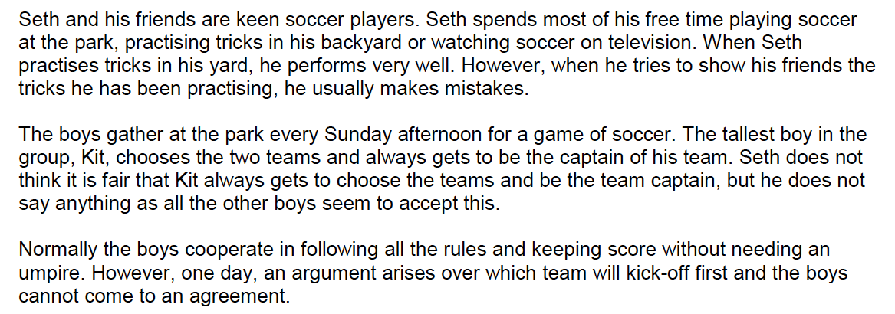
Identify and explain appropriate techniques for resolving a conflict
Read the question and the scenario carefully.
Define conflict
Identify:
the conflicting parties
the conflict (incompatible goals/ideas/behaviours)
common interests between the parties (if any)
Identify suitable techniques for resolving the conflict (mediation/negotiation/counselling)
Explain each technique, how it is applied in real life and why it is applicable to the scenario
Identify and define the types of solutions that may arise from the conflict-resolution techniques (imposed/distributive/integrative)
Identify any references to include (*quantity)
Follett, 1940: Distributive v Integrative solutions (orange analogy)
Thompson and Hastie, 1990: Interest-based negotiation
Emery et al., 2005: Effectiveness of mediation
Describe the research method and findings of (at least one) references (*quality)
Sample Question 1:
Skill Development/Guided Practice
Explain how conflicts can be resolved by applying your knowledge to the scenario above and referring to psychological evidence and understandings.
In your answer, you should discuss:
two conflict-resolution techniques the group members could use to resolve the conflict they experience
two types of solutions that could resolve the conflict in this group.

Slide 31
Identify and explain appropriate techniques for resolving a conflict
Read the question and the scenario carefully.
Define conflict
Identify:
the conflicting parties
the conflict (incompatible goals/ideas/behaviours)
common interests between the parties (if any)
Identify suitable techniques for resolving the conflict (mediation/negotiation/counselling)
Explain each technique, how it is applied in real life and why it is applicable to the scenario
Identify and define the types of solutions that may arise from the conflict-resolution techniques (imposed/distributive/integrative)
Identify any references to include (*quantity)
Follett, 1940: Distributive v Integrative solutions (orange analogy)
Thompson and Hastie, 1990: Interest-based negotiation
Emery et al., 2005: Effectiveness of mediation
Describe the research method and findings of (at least one) references (*quality)
Sample Question 1:
Skill Development/Guided Practice

Slide 32
Why is it relevant to be able to identify and explain techniques for resolving conflicts?
It is part of the Year 12 ATAR Syllabus and will help us do well our assessments and exams.
Short answer questions
Extended answer questions
Curriculum links:
Relational influences: Types of solutions to resolve conflict Imposed Distributive Integrative Techniques for resolving conflict Mediation Negotiation Counselling
Conflicts are a realistic part of life (you’ve all been and will be involved in conflicts with friends, peers, colleagues, superiors at some point in your lives). Understanding techniques for resolving conflicts and the types of solutions will give you the knowledge and the skills to be able to more effectively address conflict situations.
Why is it relevant to you?
Relevance

Slide 33
Match the techniques/solutions with the correct description
Distributive
Counselling
One party’s position is forced on another
Opposing parties try to reach a mutual agreement
Mediation
A counsellor tries to help parties come to their own resolution
Negotiation
Involves compromise by both parties
Integrative
A third party is brought in to try and resolve the conflict; arbitration is a form of this conflict resolution in which the third party has the right to hand down a decision
Win-win solutions where both parties’ interests are satisfied
Imposed
Closure

Slide 34
Identify and explain appropriate techniques for resolving a conflict
Read the question and the scenario carefully.
Define conflict
Identify:
the conflicting parties
the conflict (incompatible goals/ideas/behaviours)
common interests between the parties (if any)
Identify suitable techniques for resolving the conflict (mediation/negotiation/counselling)
Explain each technique, how it is applied in real life and why it is applicable to the scenario
Identify and define the types of solutions that may arise from the conflict-resolution techniques (imposed/distributive/integrative)
Identify any references to include (*quantity)
Follett, 1940: Distributive v Integrative solutions (orange analogy)
Thompson and Hastie, 1990: Interest-based negotiation
Emery et al., 2005: Effectiveness of mediation
Describe the research method and findings of (at least one) references (*quality)
Jarred and his younger brother Aaron share a car. On Friday night, Jarred has a date with Celia at the local cinema for the 9pm session. Aaron was hoping to go and pick up a new pair of shoes at late-night shopping in the city after he finishes work at 6pm.
Discuss the three types of conflict resolution available to the brothers and the different types of solutions they could result in.
In your answer you should:
Define conflict
Discuss three techniques for resolving conflict
Discuss three types of solutions to solve conflicts
Apply these to the given scenario
Independent Practice
You are expected to complete this task in-class and submit it to your teacher as a formative assessment

Slide 35
Learning objective 3.20: Explain Harlow, Bowlby, and Ainsworth’s contributions to attachment theory.

Slide 36
PAIR-SHARE
Identify the theories (and theorists) we have covered so far that offer explanations for how infants:
Learn (generally)
Acquire language
Who has the most influential role during a child’s first years?
Activate Prior Knowledge

Slide 37
Attachment Theory
Vocabulary
infancy: roughly the first year of life
Attachment refers to the close emotional bond or relationship between an infant and the mother (or primary caregiver).
Attachment Theory refers to the studies and models attempting to explain this relationship (Harlow; Bowlby; Ainsworth)
Concept Development
Attachment Theory suggests that:
Attachment is universal to all humans: it appears in all cultures and across all races of people.
Attachment has a biological basis: it is innate or inborn behaviour; it is instinctive not learned; its main function is to increase changes of survival by helping the child seek proximity to someone who will take care of their physical and emotional needs so that they feel secure.
Multiple attachments can occur (e.g. with a father/siblings/friends) however the mother-infant relationship is the strongest
Checking for Understanding
Define attachment. Explain why, according to attachment theory, ‘attachment’ is considered ‘universal’ and ‘biological’.

Slide 38
Attachment Theory
Vocabulary
infancy: roughly the first year of life
Attachment refers to the close emotional bond or relationship between an infant and the mother (or primary caregiver).
Attachment Theory refers to the studies and models attempting to explain this relationship (Harlow; Bowlby; Ainsworth)
Concept Development

Slide 39
Attachment Theory
Vocabulary
infancy: roughly the first year of life
Attachment refers to the close emotional bond or relationship between an infant and the mother (or primary caregiver).
Sigmund Freud suggested that love and stable relationships result from skills that begin to be learned in infancy (rather than from trial-and-error learning). He suggested that an infant’s tie to their mother is the first and the longest relationship, which will in turn act as a basis for future relationships. Freud believed that infants become attached to their mothers because they are providers of oral satisfaction (feeding) and the mother is the person most likely to feed the infant.
Harry Harlow (1958-9) explored the infant monkeys to their mothers. He concluded that Freud’s initial theory that infants formed attachment for oral pleasure was incorrect, and suggested that monkeys formed attachment more for contact comfort than for food.
Concept Development
Checking for Understanding
According to Freud, why do infants become attached to their mothers? Why did Harlow suggest that Freud’s theory was incorrect?

Slide 40
Attachment Theory – Harlow and his monkeys (1958)
Vocabulary
attachment: the close emotional bond or relationship between an infant and the primary caregiver (attachment theory aims to explain this relationship) infancy: roughly the first year of life surrogate: anyone/anything that ‘substitutes for’ or ‘plays the part of’ something else
Psychologist Harry Harlow investigated the factors influencing the development of attachments (emotional bonds) of infant rhesus monkeys to their mothers. In 1958, using 8 infant rhesus monkeys that had been separated from their mother at birth, he studied the role of feeding in infant-mother attachment.
Method:
8 monkeys were taken from their mothers at birth and kept in cages containing two surrogate mothers
The two surrogate mothers were roughly the same size and shape as the real monkey mothers and made of wire mesh. One of the surrogate mothers was covered in towelling fabric and the other was left uncovered.
A feeding bottle was attached to each surrogate in the same area where the breast would be on a real mother.
4 of the monkeys were placed in cages with the feeding bottle on the cloth surrogate and the other 4 in cages with the feeding bottle on the wire surrogate.
The monkeys were not placed in cages with other infants, as they may have preferred to comfort each other.
If an infant’s attachment to its mother was based primarily on feeding (Freud), the infant monkeys should have preferred and become attached to whichever surrogate mother had the bottle
Concept Development
Checking for Understanding
What was the aim of Harlow’s experiment? Identify the IV and the DV. Outline the procedure Harlow followed to test the effect of the IV on the DV.

Slide 41
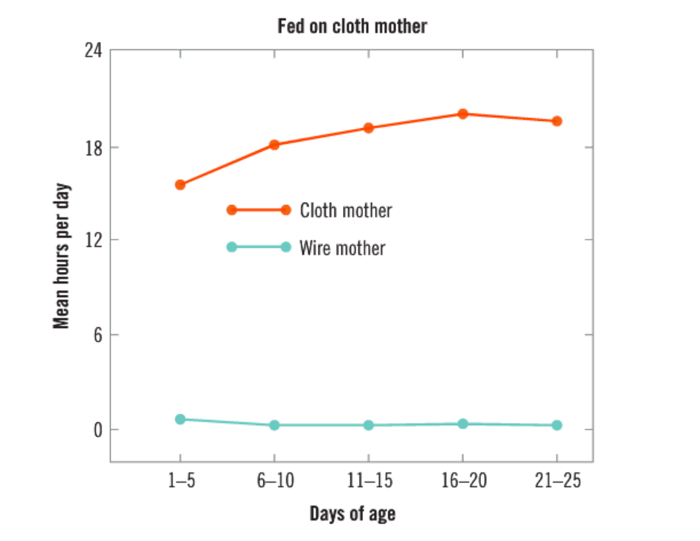
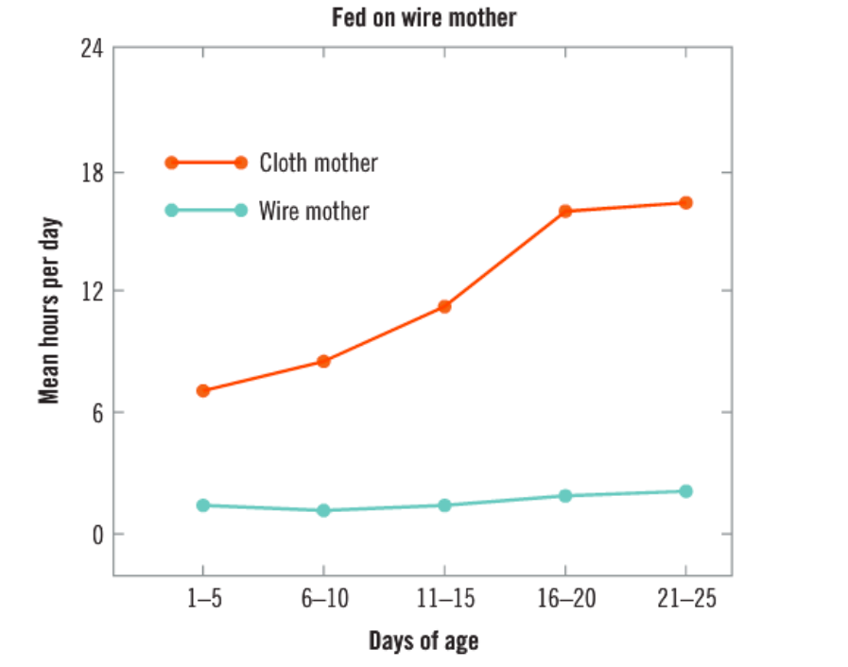
Attachment Theory – Harlow and his monkeys (1958)
Vocabulary
attachment: the close emotional bond or relationship between an infant and the primary caregiver (attachment theory aims to explain this relationship) infancy: roughly the first year of life surrogate: anyone/anything that ‘substitutes for’ or ‘plays the part of’ something else
Results:
Regardless of which surrogate provided the nourishment, the cloth surrogate was preferred to the wire surrogate
None of the monkeys would spend more than one or two hours in any 24-hour period on the wire surrogate
The infants in the two groups drank the same amount of milk and gained weight at the same rate, all 8 monkeys were spending approximately 15 hours a day in contact with the cloth surrogate
Concept Development
Checking for Understanding
Explain Harlow’s findings from this first stage of his study.

Slide 42
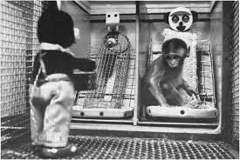
Attachment Theory – Harlow and his monkeys (1958)
Vocabulary
attachment: the close emotional bond or relationship between an infant and the primary caregiver (attachment theory aims to explain this relationship) infancy: roughly the first year of life surrogate: anyone/anything that ‘substitutes for’ or ‘plays the part of’ something else
Adding ‘stressors’
To examine what would happen if the monkeys were scared or stressed, Harlow introduced a ‘stressor’ – a mechanical moving spider and a teddy bear that beat a drum in the cages with the monkey.
Concept Development
Findings:
The results were that the terrified monkey would seek comfort from the cloth surrogate, regardless of whether or not it had the feed bottle, by rubbing its body against the cloth surrogate.
If by chance the monkey fled in terror to the wire surrogate, it would soon leave it for the cloth surrogate, even of the wire surrogate had the feed bottle.
Checking for Understanding
Why did Harlow introduce ‘stressors’ to the experiment? Explain his findings after he had introduced the stressors.

Slide 43
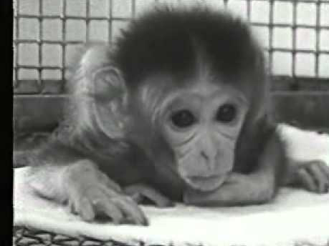
Attachment Theory – Harlow and his monkeys (1958)
Vocabulary
attachment: the close emotional bond or relationship between an infant and the primary caregiver (attachment theory aims to explain this relationship) infancy: roughly the first year of life surrogate: anyone/anything that ‘substitutes for’ or ‘plays the part of’ something else
Concept Development

Slide 44
Attachment Theory – Harlow and his monkeys (1958)
Vocabulary
attachment: the close emotional bond or relationship between an infant and the primary caregiver (attachment theory aims to explain this relationship) infancy: roughly the first year of life surrogate: anyone/anything that ‘substitutes for’ or ‘plays the part of’ something else
Harlow’s conclusions
From his results, Harlow concluded that ‘contact comfort’, which was provided by the softness of the cloth covering was more important than feeding the formation of an infant’s attachment (bond) to its mother.
Harlow generalised his finding to suggest that ‘contact comfort’ was most likely a crucial factor in human infant-parent attachment.
Concept Development
Checking for Understanding
Explain Harlow’s conclusion. How did Harlow relate his conclusion to human behaviour?

Slide 45
Attachment Theory – Bowlby’s Maternal Deprivation Hypothesis
Vocabulary
attachment: the close emotional bond or relationship between an infant and the primary caregiver (attachment theory aims to explain this relationship) infancy: roughly the first year of life
British Psychiatrist John Bowlby observed children in orphanages at the end of WWII. He found that some institutions provided a higher level of care and nurturing than other. Some provided for basic needs such as shelter and food, but lacked human contact with children.
Bowlby believed that children who had suffered loss and failure in early relationships were left more open to adverse psychological consequences later in life, such as an inability to form close relationships. Consequently, Bowlby believed that mothers should not be separated from their infants for any period of time (MATERNAL DEPRIVATION HYPOTHESIS)
What does research say?
Research into delinquent behaviour in adolescence show that delinquency is more likely to occur in children who have suffered some sort of separation experience in childhood (e.g. due to family breakdown/separation or divorce of parents). Bowlby suggests that this provides evidence to support his MDH.
Rutter (1981) proposed that the delinquency could be due to the conflict, arguing and disagreement that is often a part of family breakdown, rather than the loss of attachment to the caregiver
Concept Development
Checking for Understanding
Explain what the maternal deprivation hypothesis is. Does Rutter support or refute Bowlby’s MDH? Explain why/why not. Identify examples of evidence that would refute Bowlby’s MDH.

Slide 46
Attachment Theory – Bowlby (Phases in the development of attachment)
Vocabulary
attachment: the close emotional bond or relationship between an infant and the primary caregiver (attachment theory aims to explain this relationship) infancy: roughly the first year of life proximity: nearness
In 1969, Bowlby (and his colleagues) continued to study attachment behaviour of infants to their mothers, noting that young children maintain physical proximity to their mothers.
They observed that infants engaged in:
signal behaviours (crying, smiling) to gain the attention of their mothers, and
behaviours that physically maintained proximity, such as clinging or following a caregiver
From these studies, Bowlby suggested that there are four phases in the development of attachment:
Concept Development
Pre-attachment
Preliminary attachment
Clear-cut attachment
Goal directed partnership
Checking for Understanding
Did Bowlby engage in experimental or non-experimental research? Explain. Explain the behaviours Bowlby observed from which he concluded that children try to maintain proximity to their mothers.

Slide 47
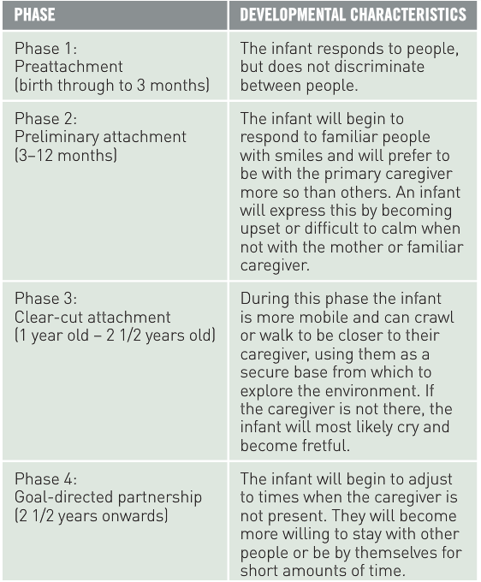
Attachment Theory – Bowlby (Phases in the development of attachment)
Vocabulary
attachment: the close emotional bond or relationship between an infant and the primary caregiver (attachment theory aims to explain this relationship) infancy: roughly the first year of life proximity: nearness
Concept Development
Checking for Understanding
Identify the differences between each phase in the development of attachment.

Slide 48
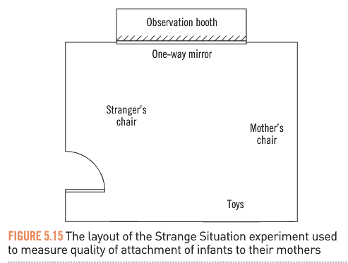
Attachment Theory – Ainsworth’ Strange Situation(1978)
Vocabulary
attachment: the close emotional bond or relationship between an infant and the primary caregiver (attachment theory aims to explain this relationship) infancy: roughly the first year of life surrogate: anyone/anything that ‘substitutes for’ or ‘plays the part of’ something else
Designed an experiment to researched the differences in the quality of attachment
Experiment took place in a room and then a fixed sequence of events was orchestrated:
The infant enters with the mother
The infant plays with mother present
A stranger enters
The mother leaves infant alone in room with the stranger (separation)
The mother returns (reunion)
The infant’s reactions were observed and recorded
Concept Development
Checking for Understanding
Describe Ainsworth’s research method.

Slide 49

Attachment Theory – Ainsworth’ Strange Situation(1978)
Vocabulary
attachment: the close emotional bond or relationship between an infant and the primary caregiver (attachment theory aims to explain this relationship) infancy: roughly the first year of life surrogate: anyone/anything that ‘substitutes for’ or ‘plays the part of’ something else
Concept Development
Checking for Understanding
Record your own observations of the infants’ reactions.

Slide 50
Attachment Theory – Ainsworth’ Strange Situation(1978)
Vocabulary
attachment: the close emotional bond or relationship between an infant and the primary caregiver (attachment theory aims to explain this relationship) infancy: roughly the first year of life surrogate: anyone/anything that ‘substitutes for’ or ‘plays the part of’ something else
From her observations, Ainsworth developed three categories of infant behaviour:
Avoidant attachment: infants seemed relatively indifferent to their mothers; exploration of the room was not affected by the absence of their mother
Securely attached: infants protested vigorously when their mother left the room; and anxiously looked for her during her absence; responded with pleasure and gave her a lively greeting when she returned; explored more when their mother was in the room
Anxiously attached: showed great distress when their mothers left the room, and were not calmed easily when she returned; appeared to be more anxious than any of the other groups – before, during and after the separation from their mother; did not actively explore the room when their mother was in the room
Concept Development
Checking for Understanding
Distinguish Ainsworth’s categories of infant behaviour

Slide 51
Attachment Theory – Ainsworth’ Strange Situation (1978)
Vocabulary
attachment: the close emotional bond or relationship between an infant and the primary caregiver (attachment theory aims to explain this relationship) infancy: roughly the first year of life surrogate: anyone/anything that ‘substitutes for’ or ‘plays the part of’ something else
Group B types infants (securely attached) were not necessarily more strongly attached to their mothers, but just more confident in her and in the relationship.
Ainsworth believes that attachment security depends on how sensitive and response a caregiver is to an infant’s signals:
Infants in Group B (securely attached) tend to have mothers who are more sensitive, accepting and expressive of affection towards them than the mothers of those who are insecurely attached (Group A or C type)
Mothers of Group A types infants are insensitive to their signals, they do not often have close body contact with their infant, and instead of being affectionate, they are often irritable and behave in an angry manner.
The mother of Group C type infants are insensitive and awkward with their infants and are not affectionate, but not as rejecting as the Group A mothers
Concept Development
Checking for Understanding
Distinguish the behaviours of the mothers of each type of infant. How, according to Ainsworth, do different responses of mothers affected attachment?

Slide 52
The Importance of Attachment on Emotional Development
Vocabulary
attachment: the close emotional bond or relationship between an infant and the primary caregiver (attachment theory aims to explain this relationship) infancy: roughly the first year of life surrogate: anyone/anything that ‘substitutes for’ or ‘plays the part of’ something else
Alan Sroufe (1985, 1990): there is a link between attachment in early life and development in later years.
Matas, Arend, & Sroufe (1978): Infants who were type B (securely attached to their mothers) in early infancy were less frustrated and happier at 2 years than were type A and C (insecurely attached infants)
Egeland (1989): Securely attached infants were more socially competent and had better academic results in Grade 3.
Concept Development
Checking for Understanding
Explain the effects of different types of attachment on emotional development. Refer to research to support your conclusion.

Slide 53
Why is it relevant to be able to identify and explain techniques for resolving conflicts?
It is part of the Year 12 ATAR Syllabus and will help us do well our assessments and exams.
Short answer questions
Extended answer questions
Curriculum links:
Relational influences: Attachment theory (Harlow, Bowlby, Ainsworth)
Attachment theory could provide explanations for relationship issues in your own lives, or in the lives of those you know well. It is also useful to know when making decisions about how to raise your own children or if you work in childcare services/education.
Why is it relevant to you?
Relevance

Slide 54

Flash quiz!
In Harlow’s experiments on infant-mother attachment, he used a clot surrogate and a wire surrogate mother. He found that infant monkeys:
Spent more time on the wire surrogate
Spent more time on the cloth surrogate
Preferred the surrogate that had the food
Spent an equal amount of time on both surrogates
Bowlby found that the first year of life and the responsiveness of the caregiver were important elements to a child’s _________later in life.
Cognitive behaviour
Social behaviour
Memory formation
Sporting ability
Signal behaviours such as crying and smiling are used by infants to:
Attract attention from their caregiver
Tell their caregiver that they are hungry
Maintain physical proximity to the caregiver
All of the above.
Closure

Slide 55
Flash quiz!
Ainsworth’s three categories of infant behaviour were:
Avoidant attachment, secure attachment, independent attachment
Secure attachment, dependent attachment, emotional attachment
Autonomous attachment, secure attachment, anxious attachment
Avoidant attachment, secure attachment, anxious attachment
Attachment refers to:
An infant’s ability to follow large objects with their eyes
The grip an infant will develop on their caregiver
The close emotional bond an infant develops with their caregiver
None of the above
When the mother went out of the room, leaving the infant in the room with the stranger during the Strange Situation experiment, an observer would record which three types of behaviours in the infant?
Any orienting response, crying or distress and habituation
Crying or distress, happiness and play, contact seeking
Closure

